Slide 1
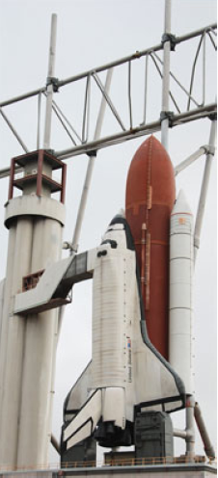



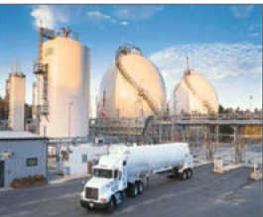

Hydrogen Energy

Slide 2


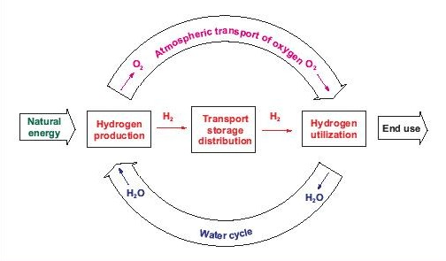
THE HYDROGEN CYCLE
I I T D
IIT Delhi
August 18, 2004
Source: T.Nejat Veziroglu ,Hydrogen Energy Technologies, UNIDO

Slide 3
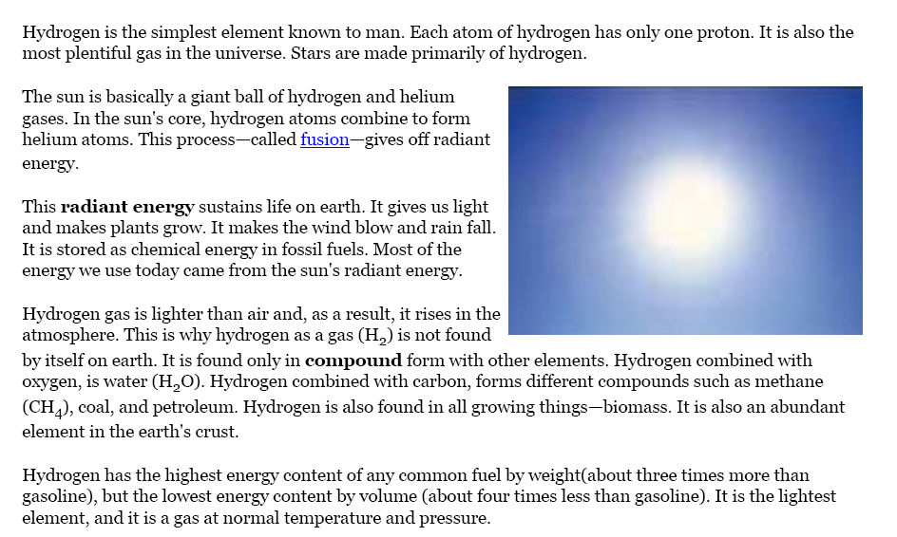
Hydrogen

Slide 4
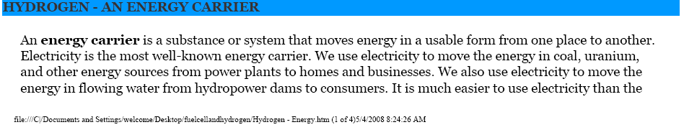
Hydrogen..

Slide 5
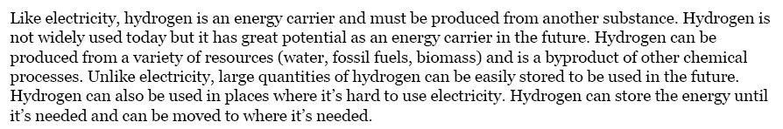
Hydrogen…

Slide 6
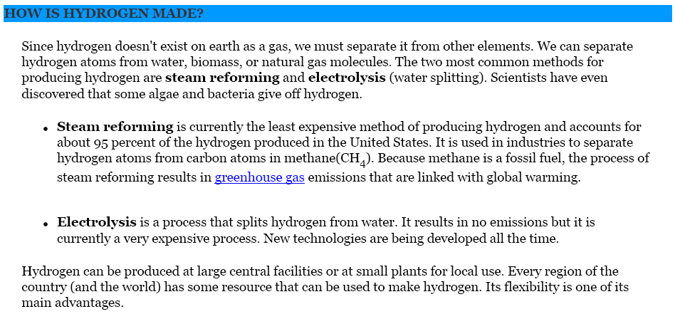

Slide 7
Hydrogen Basic
Hydrogen, or H2, is the lightest of all gases.
Commonly found in nature in compounds with other elements
It is the most abundant element in the universe.

Slide 8
Hydrogen Basic
Colorless, odorless, tasteless and nontoxic,
hydrogen exists as a gas at atmospheric temperatures and pressures.
A stable molecule because of its high bond strength, hydrogen becomes reactive at elevated temperatures or with the aid of catalysts.
When cooled to its boiling point of -423°F (-253°C), hydrogen becomes a liquid that is approximately 93 percent lighter than water.
All other gases - except helium - become solids at this temperature.
Hydrogen is flammable and burns in air with a pale blue, almost invisible flame.
In its gaseous form, hydrogen dissipates quickly. These unique properties call for strict safety measures in hydrogen use and storage.

Slide 9
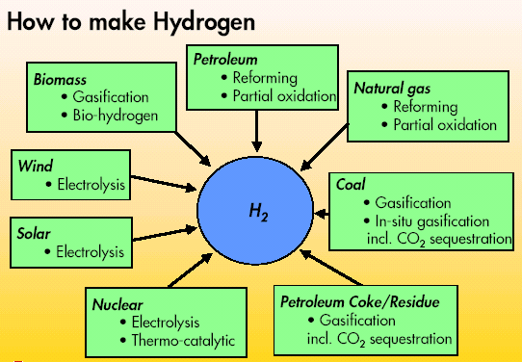
I I T D
IIT Delhi
August 18, 2004
PRODUCTION
Source: T.Nejat Veziroglu ,Hydrogen Energy Technologies, UNIDO

Slide 10
What is Hydrogen Fuel?
Hydrogen does not occur free in nature in useful quantities, but it is manufactured in a number of ways.
It can be made from natural gas or it can be made by passing electric current through water.

Slide 11
Advantages of Hydrogen Fuel
When hydrogen is burned, the only emission it makes is water vapor, so a key advantage of hydrogen is that when burned, carbon dioxide (CO2) is not produced.
Clearly, hydrogen is less of a pollutant in the air because it omits little tail pipe pollution.
Hydrogen has the potential to run a fuel-cell engine with greater efficiency over an internal combustion engine.

Slide 12
Disadvantages
Currently, it still costs a considerable amount of money to run a hydrogen vehicle because it takes a large amount of energy to liquefy the fuel.
Research shows that cars could store hydrogen in high pressure tanks like those used for compressed natural gas.
The Department of Energy's goal is to produce hydrogen at $2 to $3 per gallon by 2015. Right now, the cost per gallon is between $6 and $8.

Slide 13

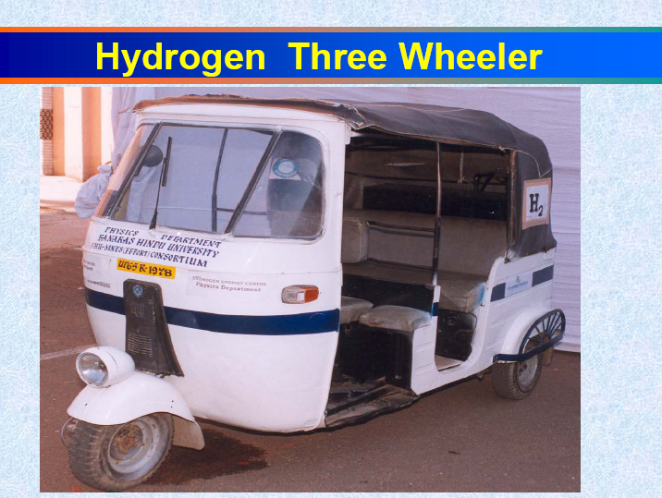
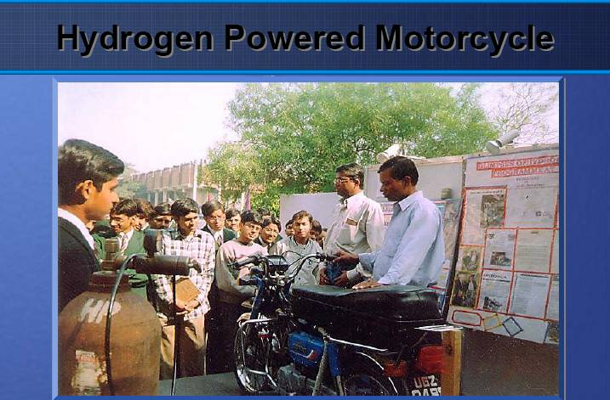



Slide 14
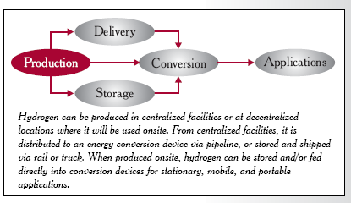
Production

Slide 15
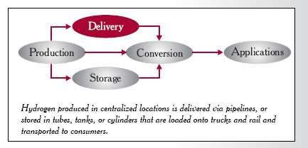
Delivery

Slide 16
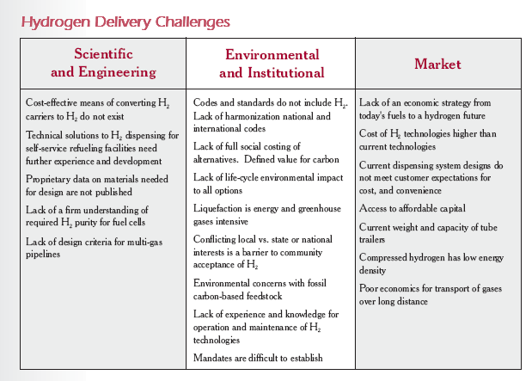
Hydrogen Delivery Challenges

Slide 17
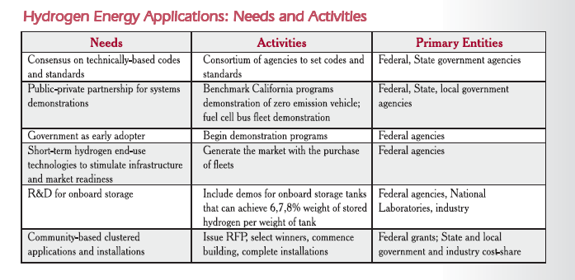
Needs and Activiteis

Slide 18
Other Uses of Hydrogen
Hydrogen is used extensively today to make ammonia, methanol, gasoline, heating oil, and rocket fuel.
It is also used to make fertilizers, glass, refined metals, vitamins, cosmetics, semiconductor circuits, soaps, lubricants, cleaners, and even margarine and peanut butter. Hydrogen can fuel today’s internal combustion engine vehicles.
Hydrogen can replace today’s natural gas for heating and cooling homes and powering hot water heaters.
Existing wind and hydroelectric plants can produce hydrogen to store energy during off-peak hours.
Hydrogen production from hydrocarbons can also produce carbon, which in some forms has ten times the strength of steel. With more research, this carbon could be used for automobile bodies and structural members.

Slide 19
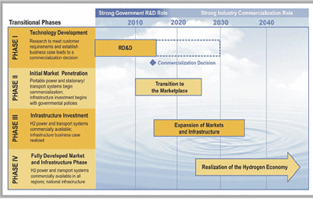
Perspective: current hydrogen market (current hydrogen economy)

Slide 20
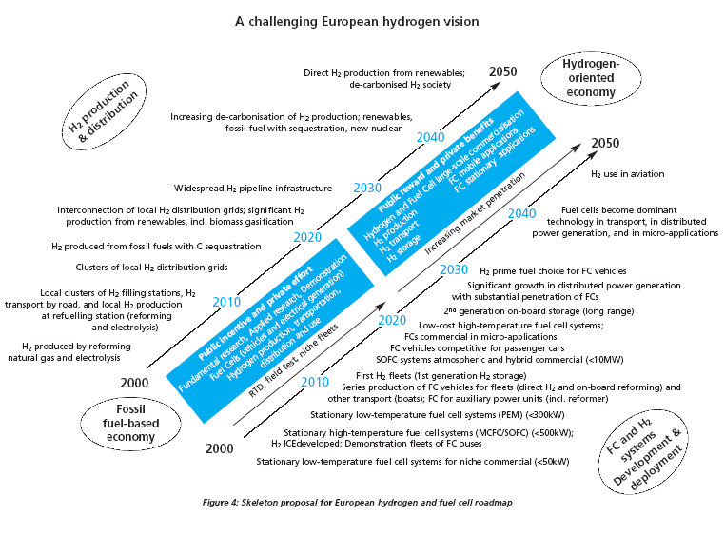

Slide 21
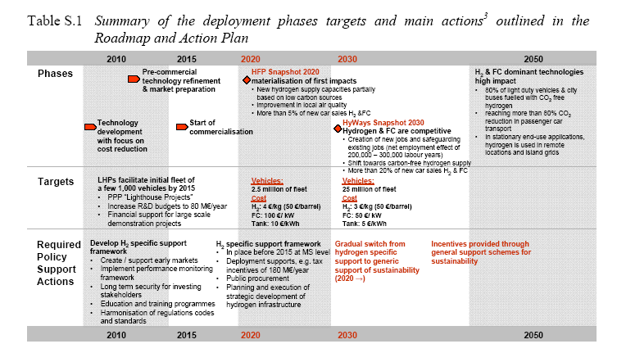
Road Map and Action Plan

Slide 22
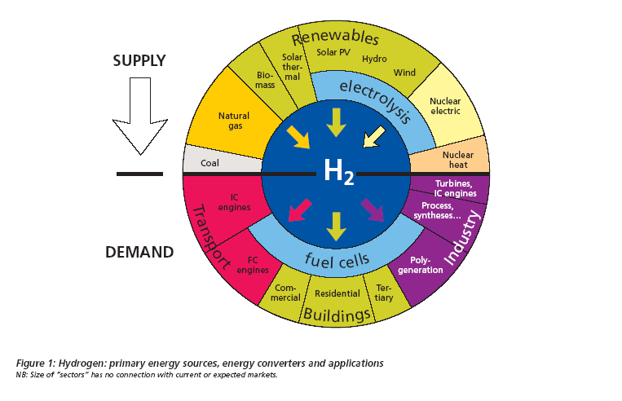
Hydrogen- Supply and Demand

Slide 23
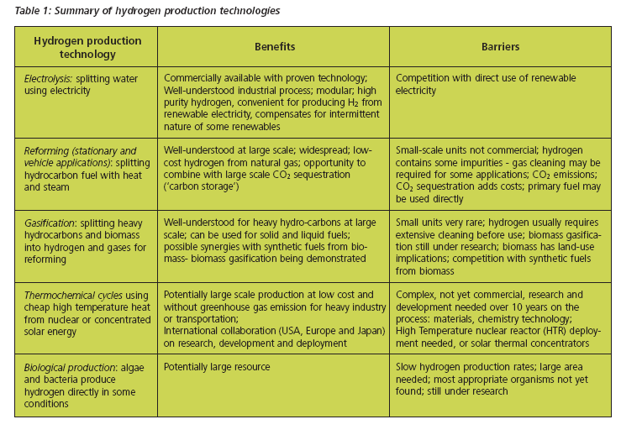
Technology- Benefits and Barriers

Slide 24
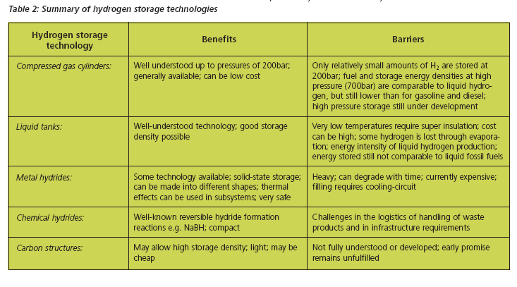
Hydrogen Storage Technology- Benefits and Barriers

Slide 25
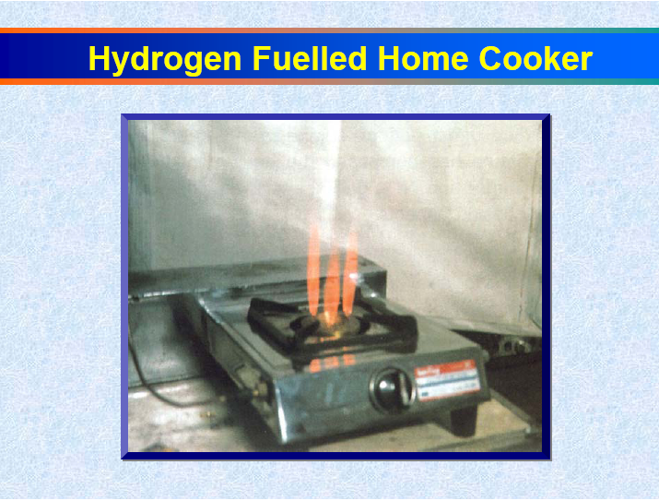
Hydrogen burning on cookstove

Slide 26
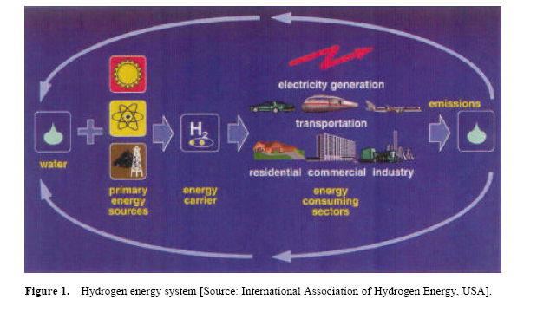
Hydrogen Energy System

Slide 27
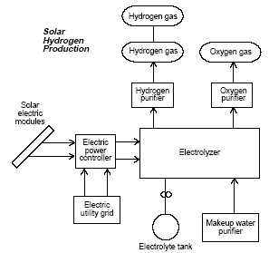
Solar Hydrogen
Production by
Electrolysis

Slide 28
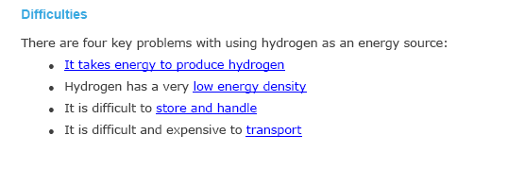
Difficulties

Slide 29
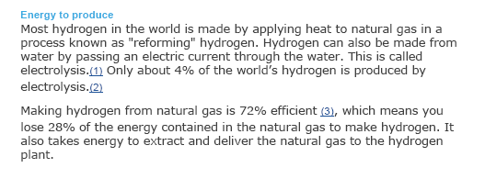
Difficulties…

Slide 30
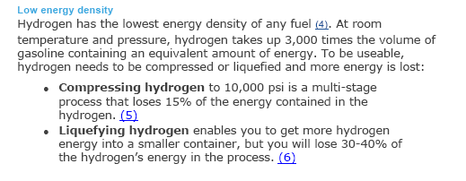
Difficulties…

Slide 31
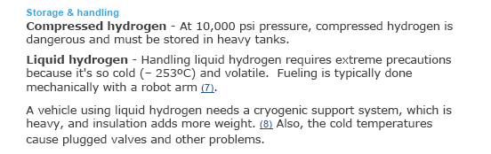
Difficulties….

Slide 32
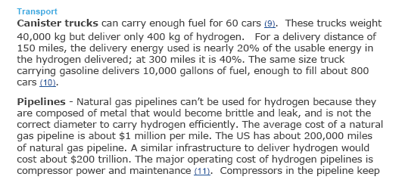
Difficulties…

Slide 33


